Slide 1

Handwritten Number Recognition Using Support Vector Machine Machine Learning Project 1
Prepared by:
Kheesheshta Ramgoolam Sobun (230006662)
Sorna Raja Shanmuga (230026043)
Youngseob Dae (160035865)
Paul Gin Hwan Cheung (230062281)

Slide 2
Project Objectives and Design Process
Defines the structure and operations of the SVM model, including initialization, fitting the training data, making predictions and calculating model accuracy and hinge loss
Training process involves adjusting the weights (‘w) and bias (‘b’) to minimize hinge loss
Fetches the MNIST Dataset from OpenML or Keras Dataset,splits the data into training (60000) and testing(10000) sets and applies feature scaling
Step 1
Step 2
Loading Data
Building the SVM Model
To learn the model parameters that best separate the different classes in the MNIST dataset.
For each class in the dataset, a binary classifier is trained in a one-vs-all fashion, distinguishing each digit from all other digits
Visualize the model's training progress and its performance on the testing set.
Loss and accuracy over iterations provide insights on the model’s learning and convergence behaviour
Confusion matrix is the heatmap visualization ,helping to identify which digits the model confuses most frequently
Step 4
Step 3
Step 5
Accuracy/ Loss Plots,Confusion Matrix
Testing of Dataset
Training on MNIST Dataset
To evaluate the model's performance on unseen data.
After training, the model makes predictions on the testing set to assess its generalization ability.
The ‘predict’ method applies learned model parameters to the features of the testing set, outputting the predicted classes for each instance.
Handwritten Digits Recognization Process
Notes:
Feature scaling is performed by dividing the pixel values by 255.0, normalizing them to a range of 0 to 1 to improve the SVM model's convergence during training.
Step 3 The SVM model is trained using the training data split from the MNIST dataset. For each class in the dataset, a binary classifier is trained in a one-vs-all fashion, distinguishing each digit from all other digits. This step involves iterative adjustments to the model's weights and bias based on the training data to minimize classification errors.

Slide 3
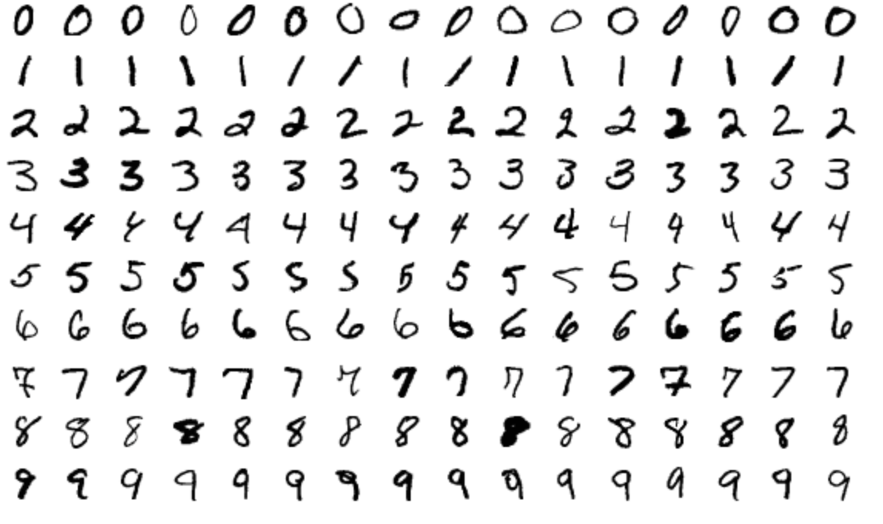




MNIST Dataset
It consists of a large collection of 70,000 handwritten digits, divided into a training set of 60,000 examples and a test set of 10,000 examples.
It can be loaded directly into Python using libraries like TensorFlow, PyTorch, or through the Deep Lake open-source package
MNIST (Modified National Institute of Standards and Technology database)
It is a foundational dataset in the field of machine learning, particularly for tasks involving image processing and pattern recognition.
The dataset serves as a benchmark for evaluating the performance of various image processing systems, including those based on neural networks and other machine learning techniques.
http://yann.lecun.com/exdb/mnist/
3

Slide 4
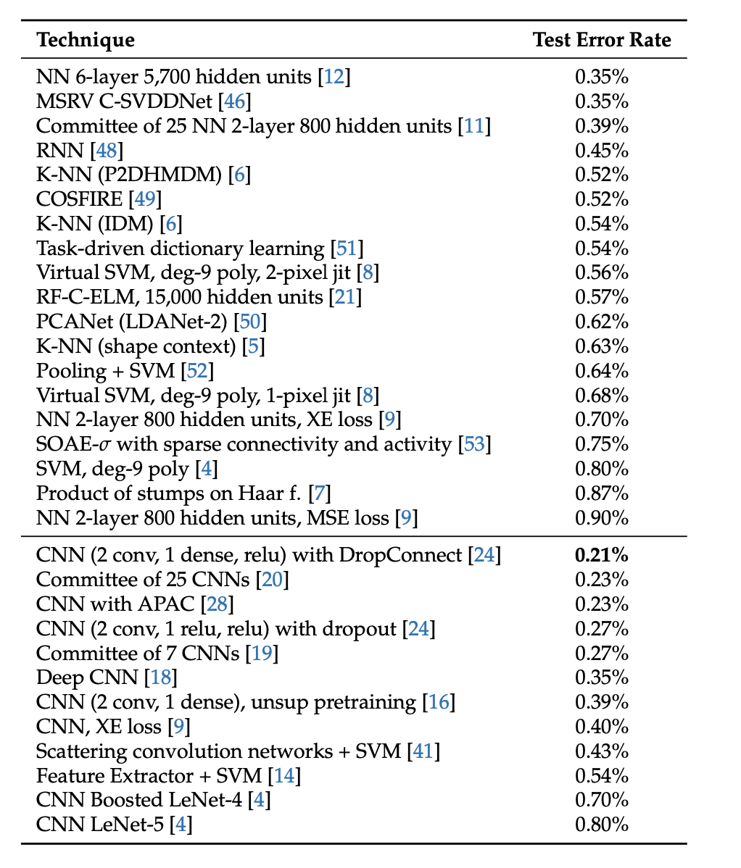
A Survey of Handwritten Character Recognition with MNIST and EMNIST
Notes:
based on the research the most common methods to tackle this problem is using polynomial svm or cnn where we have less error rate

Slide 5

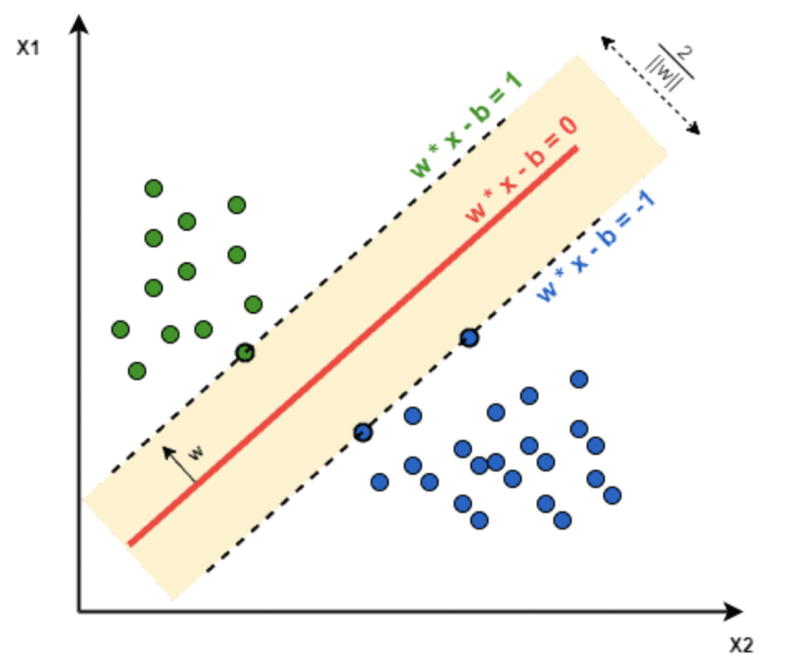



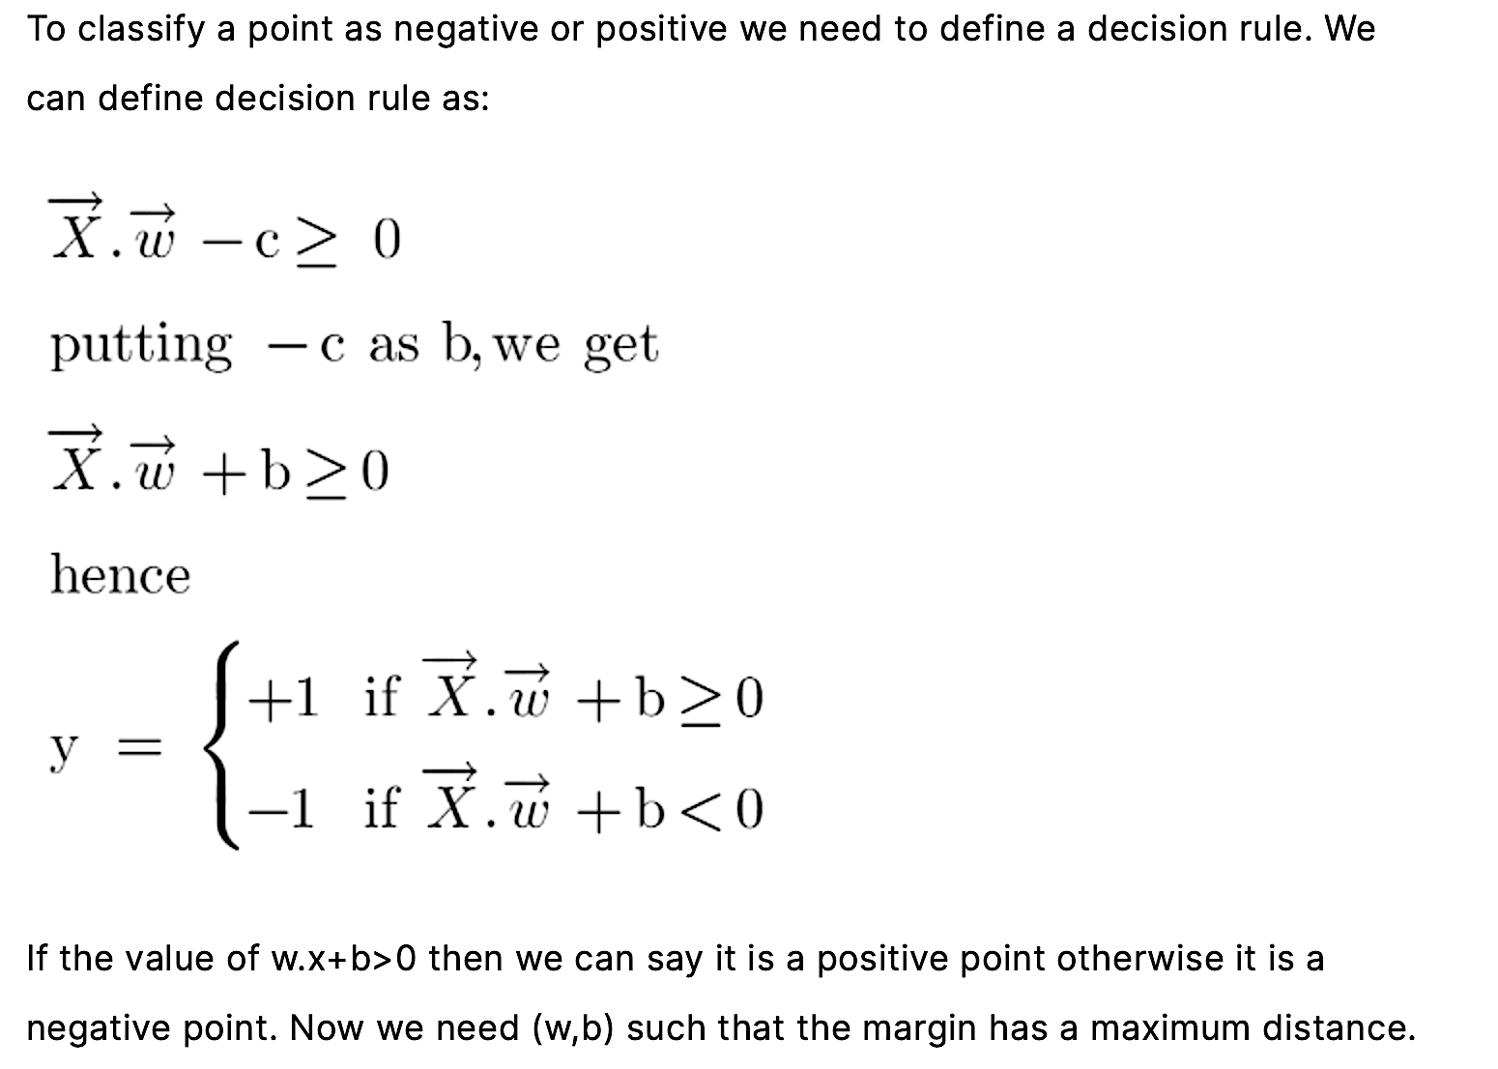

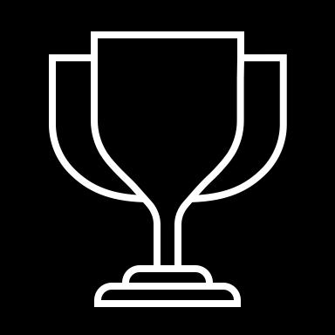


Introduction to Support Vector Machine
SVM is a supervised machine learning algorithm that helps in both classification and regression problem statements.
It tries to find an optimal boundary (known as hyperplane) between different classes.
What is SVM?
Working of SVM
In the simplest form where there is a linear separation, SVM tries to find a line that maximizes the separation between a two-class data set of 2-dimensional space points.
To find a hyperplane that maximizes the separation of the data points to their actual classes in an n-dimensional space. The data points which are at the minimum distance to the hyperplane i.e, closest points are called Support Vectors
Objective of SVM
Linear SVM
Non-Linear SVM
When the data is perfectly linear separable only then we can use Linear SVM.
Separable means that the data points can be classified into 2 classes by using a single straight line(if 2D).
When the data is not linearly separable then we can use Non-Linear SVM, which means when the data points cannot be separated into 2 classes by using a straight line (if 2D)
then we use some advanced techniques like kernel tricks to classify them.
Notes:
equation of a hyperplane is w.x+b=0 where w is a vector normal to hyperplane and b is an offset.

Slide 6
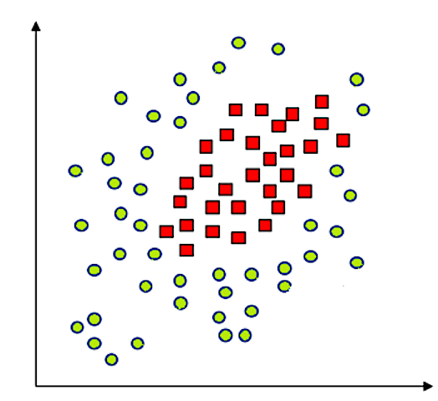
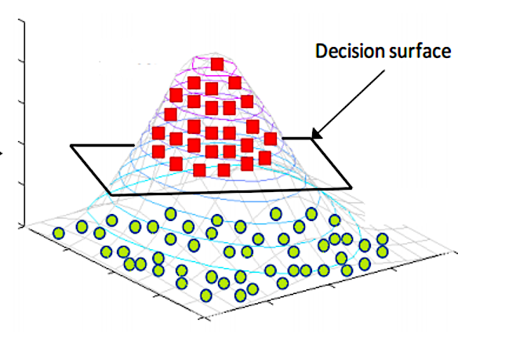
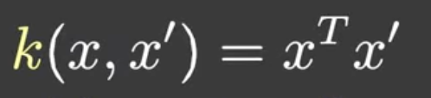
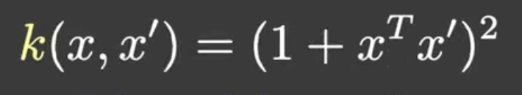
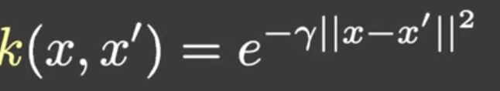
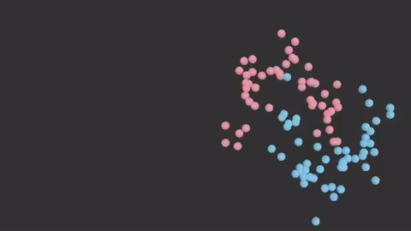
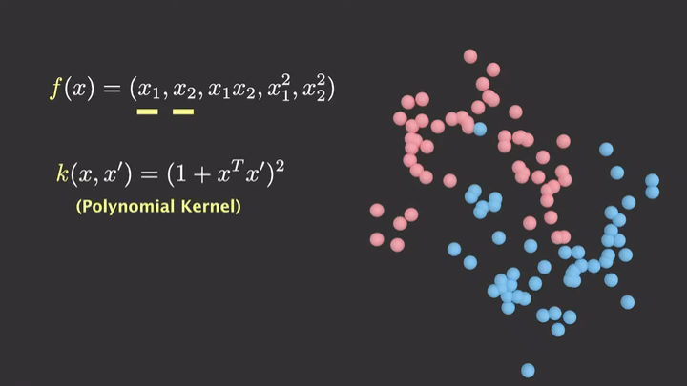
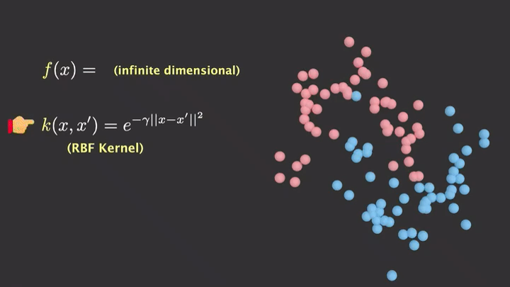
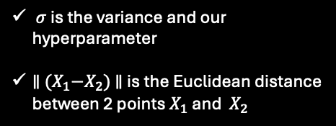
Kernels
Kernels
Linear Kernel
Polynomial Kernel
RBF Kernel
d is the degree of the polynomial which need to specify manually
$σ$ is the variance and our hyperparameter
$∥$ ${(X}_{1}−X_{2})$ $∥$ is the Euclidean distance between 2 points $X_{1}$ and ${ X}_{2}$
Notes:
Kernal- Transformation / helps algorithm / find suitable representation of data.
Transforming / input space to higher dimensionsonal Space.
How do you want to perceive your maze??
Kernal/ special glass / maze in different ways.
* Linear Kernal - maze view/ straight grid of lines
* polynomial Kernal - glass / bends the walls / creating curves
* RBF Kernal - glass / wraps the maze / into space / every point is unique
Gamma - Light to see clearly
* HG - Narrow Bean / focusing nearby parameters
LG - Wide Beam / broader view of pathway
x’ = landmark

Slide 7



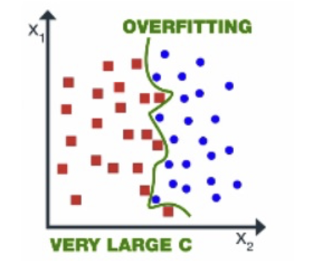
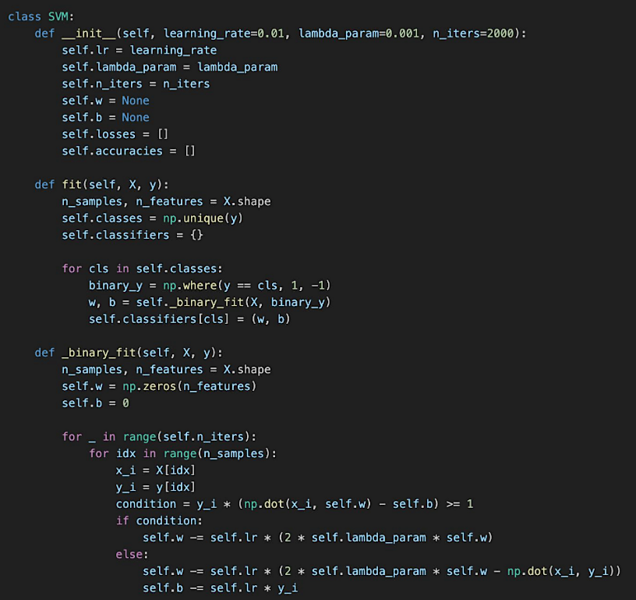
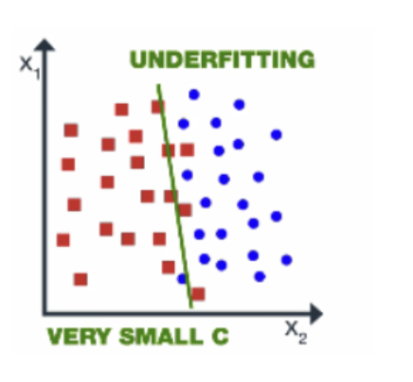
SVM Model
Initialisation
Fitting the Model
Classification Training
01
02
03
Initializes the SVM model with predefined learning rate (lr), regularization parameter (lambda_param), and the number of iterations (n_iters)
Prepares to store the model weights (w) and bias (b), as well as lists to track the hinge loss and accuracy across iterations (losses and accuracies), for each classifier.
Prepares the model to learn from the data X and labels y.
For each class, creates a binary label (binary_y) where the current class is marked as 1 and all others as -1, transforming the multiclass problem into multiple binary classification problems.
Invokes _binary_fit for each binary problem to learn the weights (w) and bias (b), and stores these in classifiers dictionary, keyed by class.
Initializes weights w as a zero vector of dimension equal to the number of features in X, and bias b as 0.
Iterates n_iters times over the dataset, applying the gradient descent update rule based on the SVM hinge loss function:
Lambda_param = small
Lambda_param = large
Notes:
Initialization - Setting up the parameters /model / before training.
1. Learning rate - how fast / carefully model can learn
* HLR - Long steps / missing details / overshooting / shorter time
* LLR - short steps / intricate details / longer time
2. Lambda - controls complexity / preventing overfitting
* HL - Simple path / focusing landmarks / undefitting
* LL - memorizing intricating details / overfitting
3. Weights - multiple paths/ Dead end, long route, short route / assigning hight weight to short
4. Bias - starting point that helps steer our decision even if the features are not informative
5. n iters - no. of iterations / improvising from previous model
‐-----‐-------------------------------------
Fitting- Prepares model / learn from X & Y
Transformation/ multiclasses/ multiple binary classes
Each class / binary label/ current class is 1 & others are -1.
‐-----‐-------------------------------------
Training - Stochastic Gradiet Descent (SGD) / optimzation technique / better W & B / for training
Process Involved
* Random Exploration
* Take a step
* Learn from mistakes
* Repeat

Slide 8






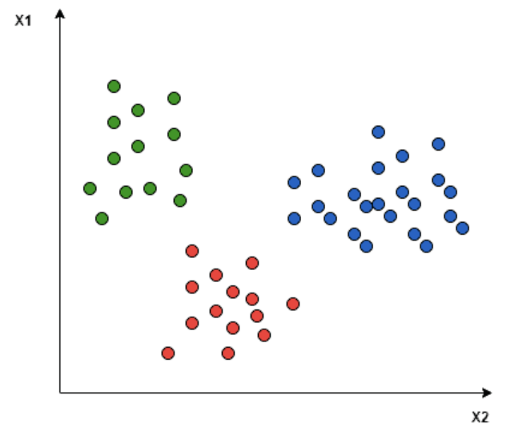
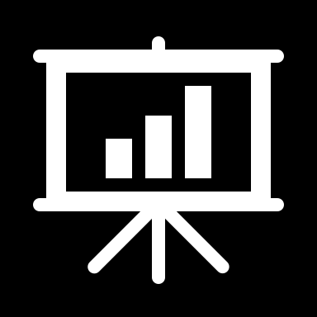

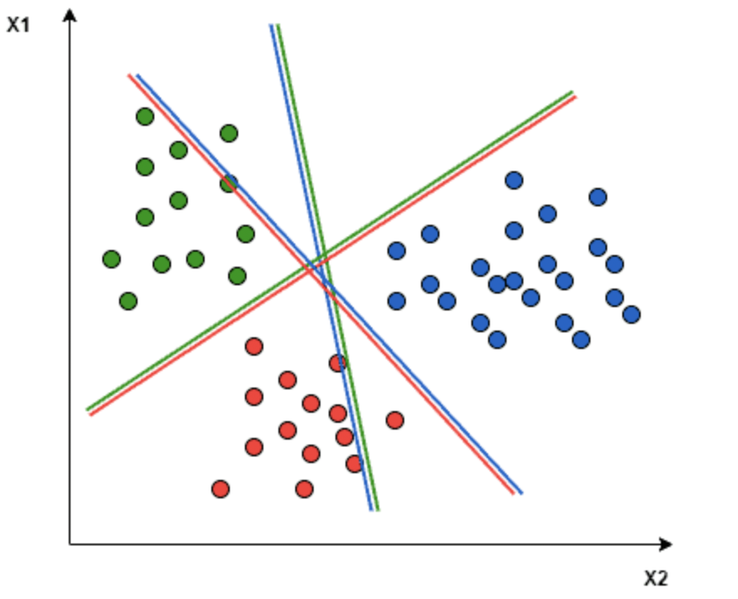
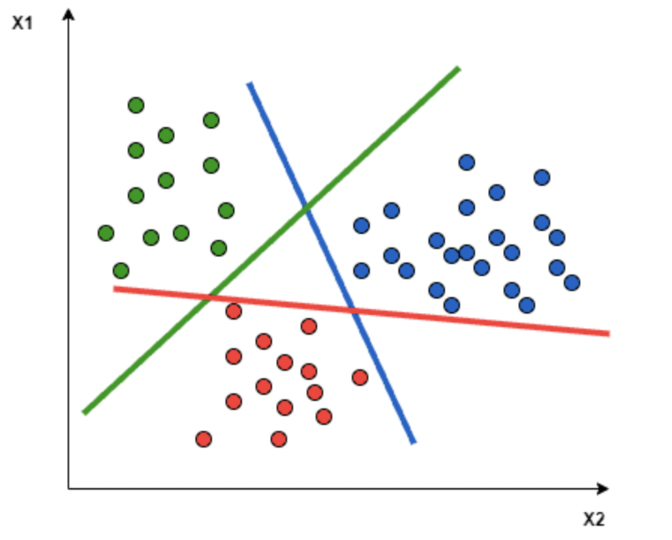
Training & Testing the SVM Using One Versus ALL Classifier
One vs One (OVO)
Better
Computational
Efficiency
One vs All (OVA)
Low Training &Prediction time
OVA requires only 10 binary classifier while OVO requires training N*(N-1)/2 =45
Directed Acyclic Graph (DAG)
With OVR, we can train 10 classifiers, while with OVO, we can train 45 classifiers for each class against the rest
.
Imbalanced Class Distribution
OVR is less affected by imbalanced class distribution compared to OVO.
Scalability
OVR scales better with the number of classes
Robustness to Overlapping Classes
OVO
OVA
OVR performs better when classes overlap
Digits 4 , 9 or 3 and 8 may ovelap in appearance.
Notes:
The OVO approach breaks down the multiclass problem into binary subproblems.
The OVA trains separate SVM classifiers for each class.
DAG offers a hierarchical grouping approach, reducing diversity from the majority class.
For instance, let’s consider a scenario with three class classification problems: Green, Red, and Blue.
In the One-to-One approach, we aim to identify the hyperplane that separates every pair of classes, disregarding the points of the third class. For example, the Red-Blue line maximizes separation only between blue and red points, without considering the green points.
In the One vs All approach, a hyperplane is sought to separate the classes, considering all points and dividing them into two groups: one for the points of the class being analyzed and another for all other points.

Slide 9
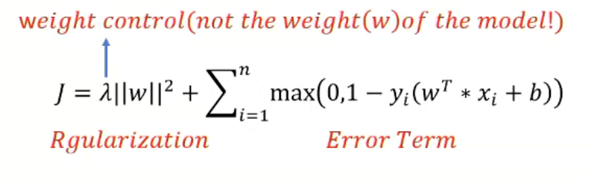
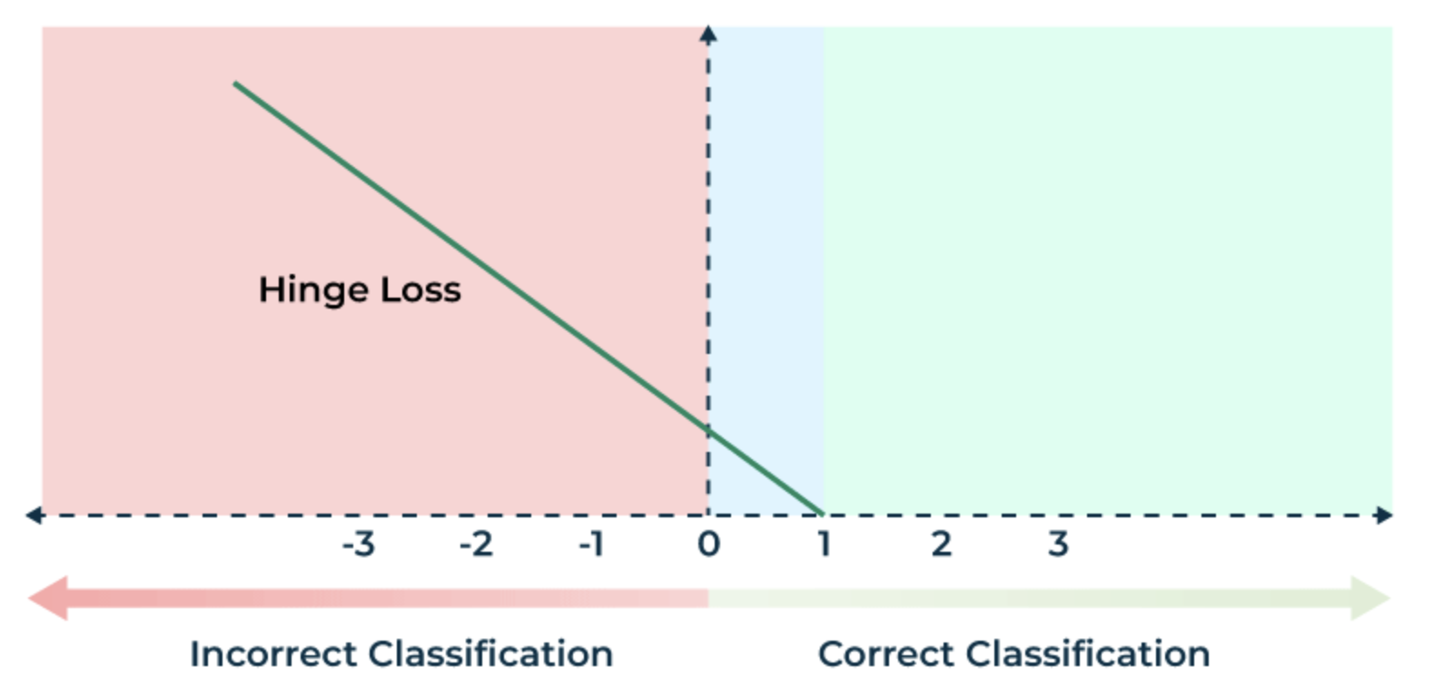
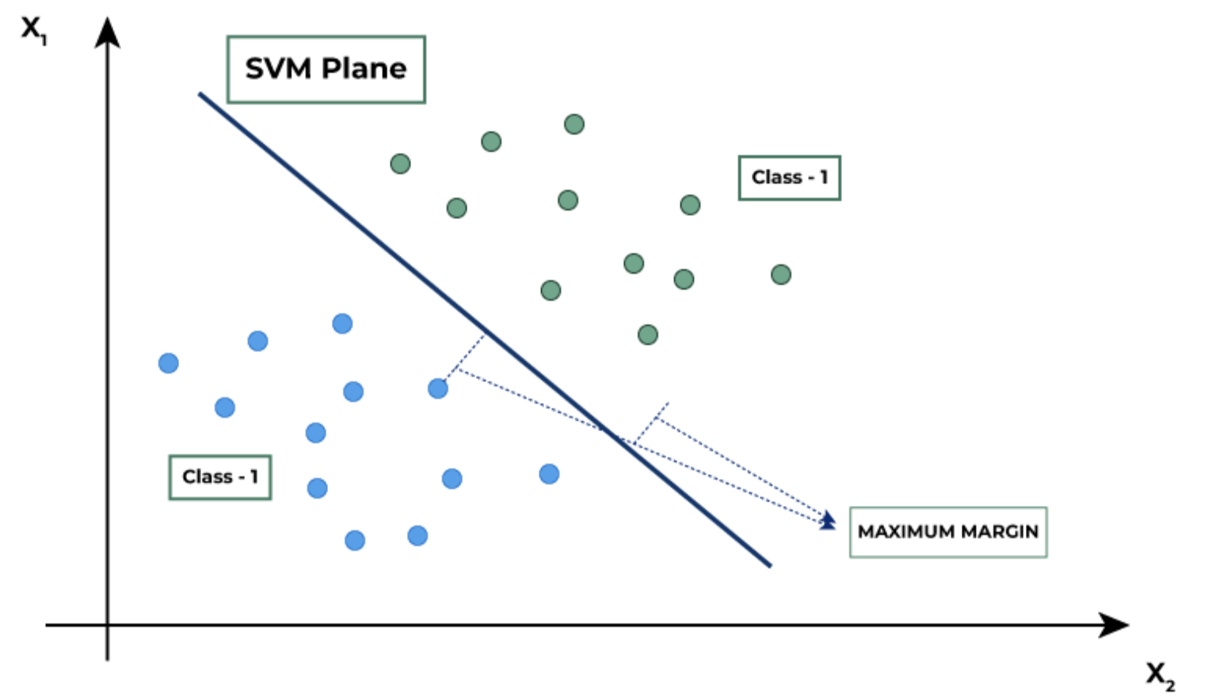
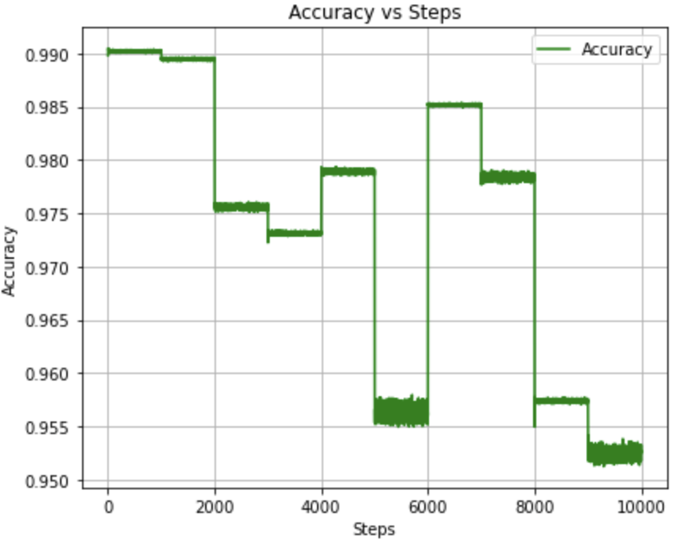
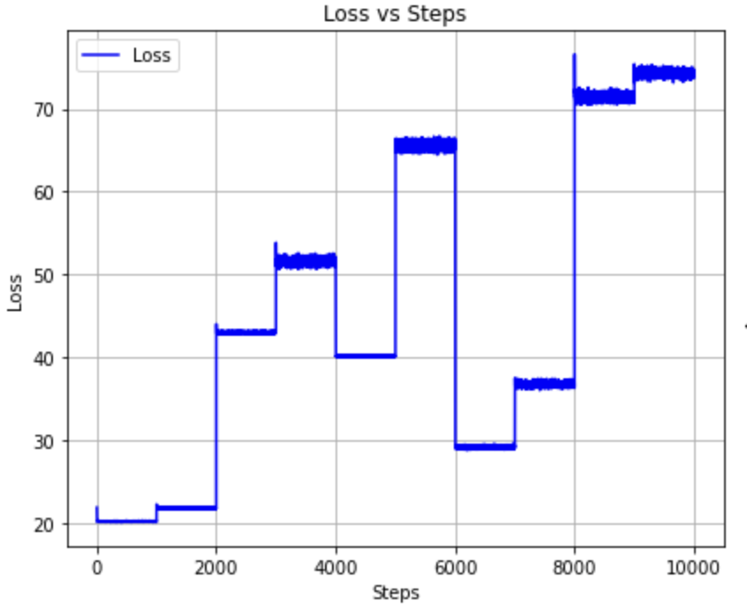
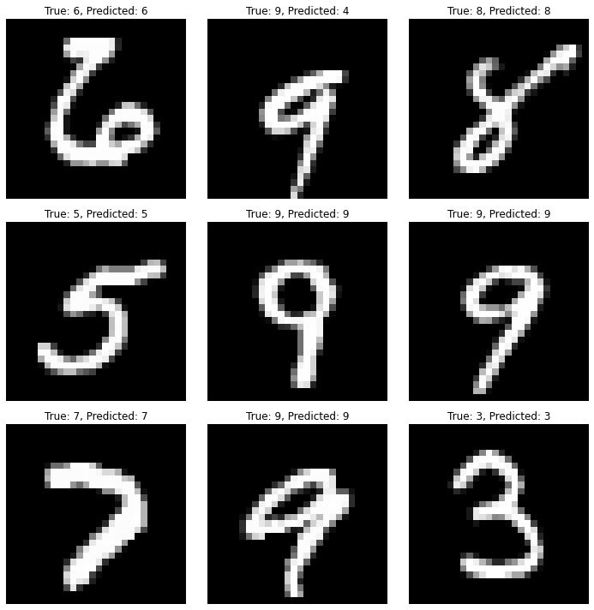
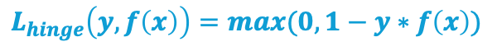
Results
Loss vs Steps
Accuracy vs Steps
Calculates accuracy of the model using current weights, bias, input features, and target labels
Calculates hinge loss using current weights, bias, input features, and target labels. Hinge loss for a data point can be defined as follows
$$L_{hinge}\left(y,f\left(x\right)\right)=max(0,1−y∗f\left(x\right))$$
SVM Model | Accuracy
Scratch_Linear | 0.8955
Inbuilt_Linear | 0.8961
Inbuilt_RBF | 0.9444
Notes:
y- the actual class (-1 or 1)
Loss: It typically represents the difference between the predicted outputs of the model and the true outputs during training. Lower loss values indicate better performance
Steps: corresponds to the training steps or gradient descent updates
The plateau regions, where the loss remains constant for a series of steps, suggest that the model is not learning during these periods.
This could be due to several reasons such as the learning rate being too low, the model reaching the limits of what it can learn from the data, or potentially overfitting(increase lamda) to the training data without improving generalization.
After each spike, the loss tends to decrease to a level that is lower than before the spike, suggesting that the model is eventually learning and improving from the new challenges it encounters.
Towards the end of the graph, the loss stabilises suggesting that the model is not experiencing significant learning and may have reached a convergence point.
F(x) = wT * x + b

Slide 10
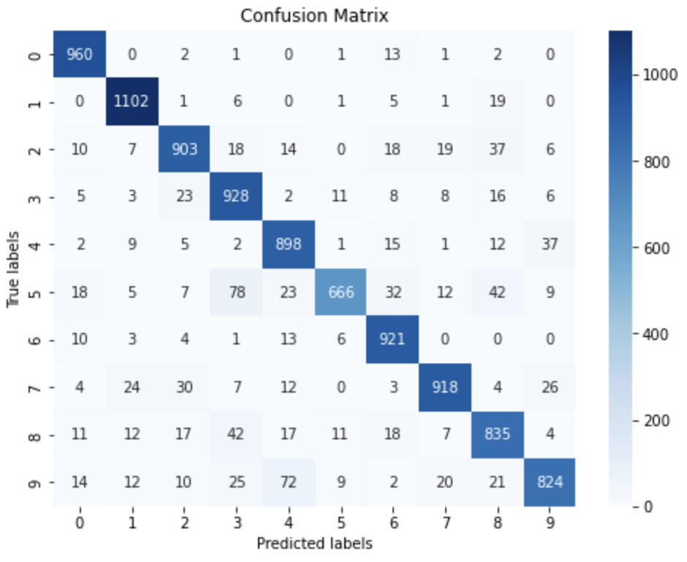
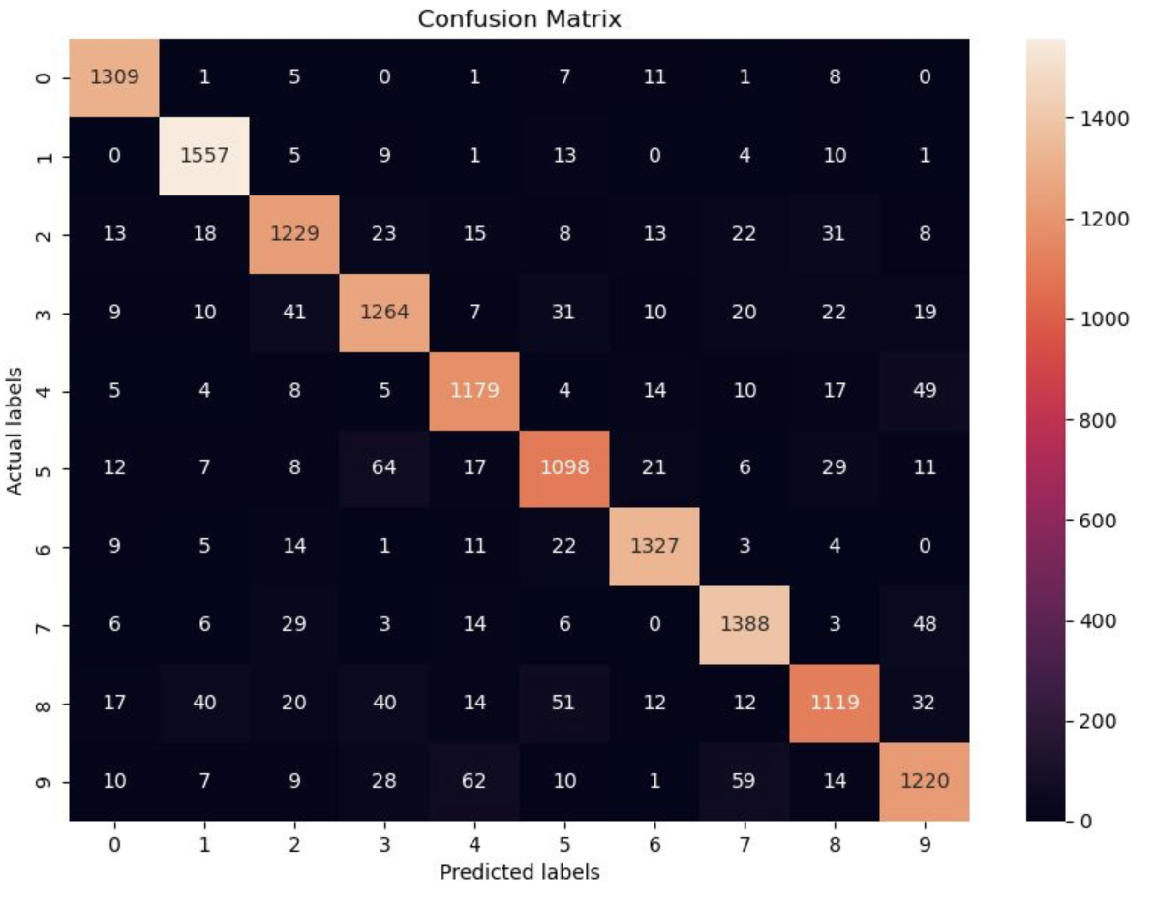
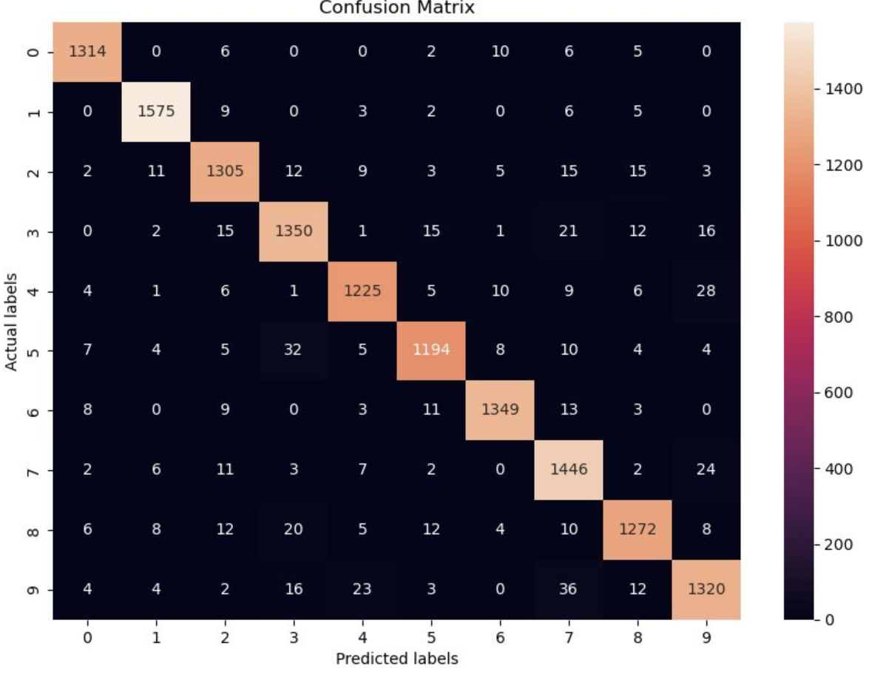
Confusion Matrix
Our SVM Model from Scratch
Kernel : ‘Linear’
Inbuilt SVM Model from Library
Kernel: ‘Linear’v
Inbuilt SVM Model from Library
Kernel: ‘RBF’
Distribution of Predictions
In our Confusion Matrix(Blue), the predictions appear to be more concentrated along the diagonal, indicating a higher number of correct classifications for each class.
The confusion matrix from inbuilt SVM library shows a broader spread of values across both the diagonal and the off-diagonal elements.
Scale of Values
The blue matrix (linear kernel) has lower absolute values across both diagonal (correct predictions) and off-diagonal (incorrect predictions) elements. This suggests that the the classifier is more conservative in its predictions.
In contrast, the red matrix (linear kernel) has higher values overall, with particularly high values on the diagonal. This could imply that the classifier is more confident (which could be due to a parameter setting(higher C of 0.01).
The RBF kernel seems to separate some classes better. For example, there are fewer misclassifications between classes 1 and 8. This suggests that the RBF kernel may be capturing more complex relationships in the data.
Notes:
As you can see here, we also compare our confusion matrix with inbuilt svm. In contrast with our custom svm, inbuilt linear kernel has higher values overall, with particularly high values on the diagonal.
This could imply that the classifier is more confident (which could be due to a hyperparameter tuning with C =0.01.
Also, these values were even well-classified by RBF kernel. Misclassification values are smaller than linear kernel. Let’s take an example as true label of 5. In our custom code, it was misclassified 78 times, in linear kernel it became smaller with 64. This becomes half (32) in RBF kernel. This suggests that the RBF kernel would be capturing more complex relationships in the data.

Slide 11
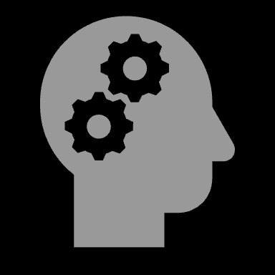
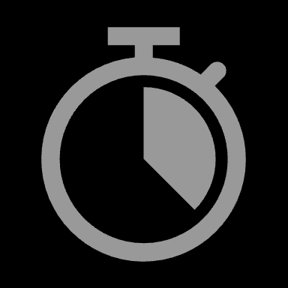




§
Improvements
Optimisation Algorithm
Kernel Selection
We can use more advanced optimization algorithms of mini-batch gradient descent
SVMs can use different kernel functions (e.g., linear, polynomial, RBF) to map the input data into a higher-dimensional space. Experimenting with different kernel functions might lead to better result
Hyperparameter Tuning
Improving SVM Model
Cross Validation
Experiment with different values for hyperparameters such as learning rate, lamda parameter, and num of iters
Use techniques like grid search
Perform k-fold cross-validation to get a more robust estimate of the model's performance
Model Evaluation Metrics
Feature Scaling
Normalising input features can improve performance of SVM models, especially when inputs have different scales
Besides accuracy, consider using other evaluation metrics like precision, recall, F1-score, or ROC AUC, especially if the classes are imbalanced.
Notes:
Slide 11 – Improvements
Finally, we are going to suggest potential improvements for better performance. First, it would be better-optimised to implement some advanced algorithms such as stochastic gradient descent (SGD) or mini-batch gradient descent. It can lead to faster convergence since SGD updates model parameters by making progress before seeing the entire dataset, and mini batching needs fewer calculation by making a small subset of training data. Hyperparameter tuning, like adjusting the learning rate and regularization, can fine-tune our model's performance. By using grid search this would give us better results. And Feature scaling would be applicable as well. By normalising input features of pixels in dataset to range between 0 and 1, the algorithms would behave better because the feature space is bounded and more consistent.
[9:30 PM, 27/03/2024] Sheshta:

Slide 12
THANK YOU!
Q&A?

Slide 13
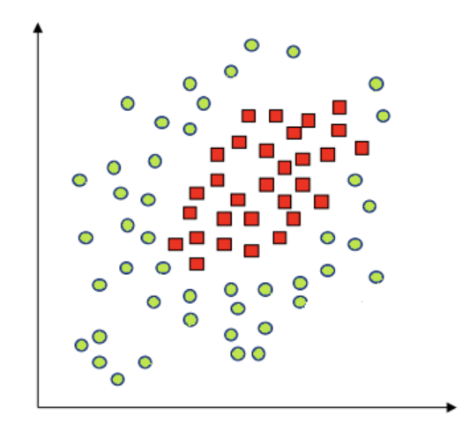



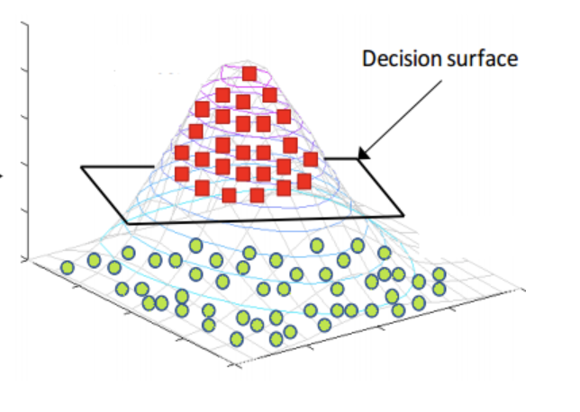
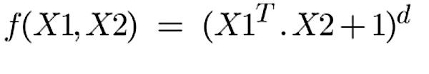
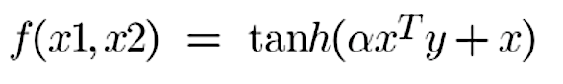
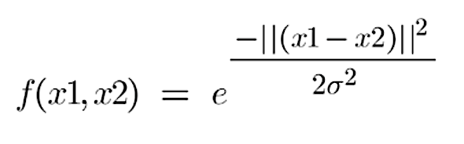
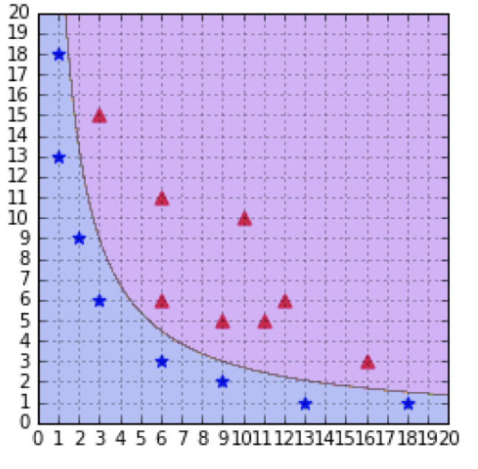
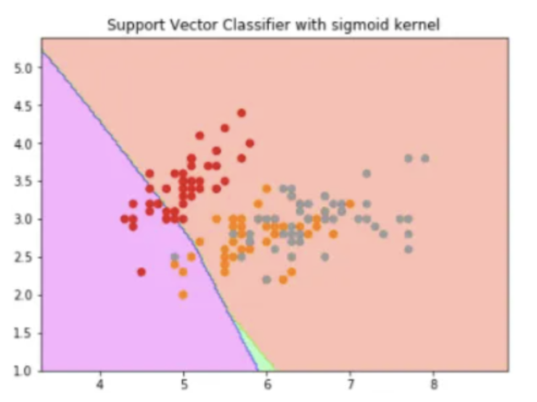
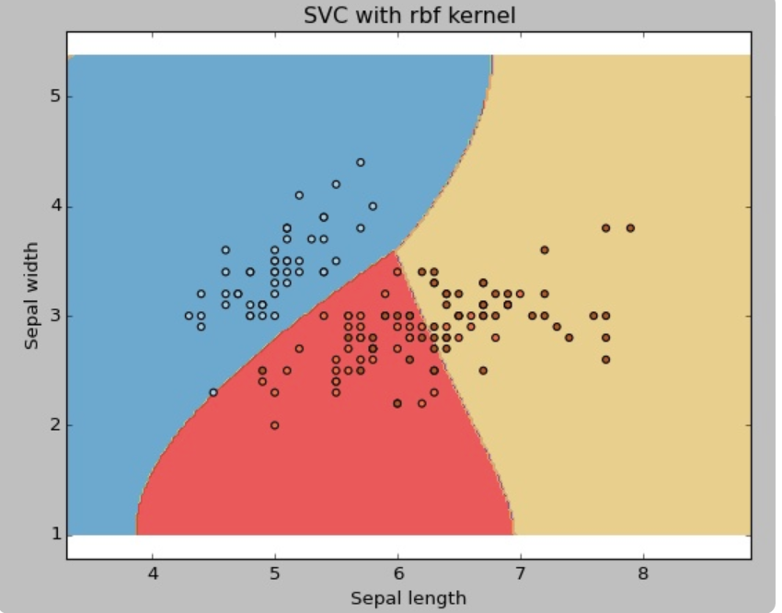
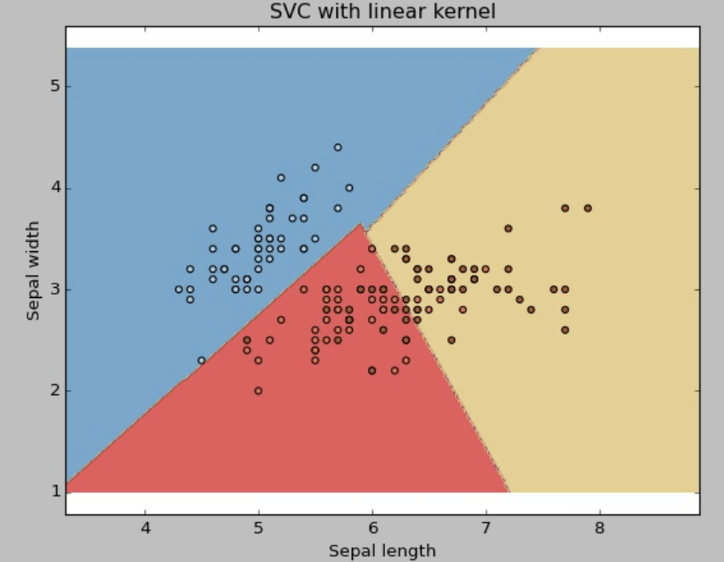
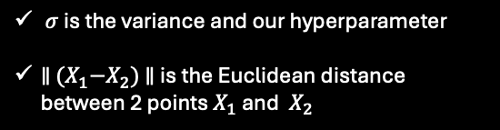
Kernels
Kernels
Polynomial Kernel
Sigmoid Kernel
RBF Kernel
Linear Kernel
d is the degree of the polynomial which need to specify manually
Mapping inputs to a value of 0 and 1 so that they can be separated by a simple straight line
$σ$ is the variance and our hyperparameter
$∥$ ${(X}_{1}−X_{2})$ $∥$ is the Euclidean distance between 2 points $X_{1}$ and ${ X}_{2}$
Notes:
In Support Vector Machine (SVM) models, the choice of kernel is crucial for determining the decision boundary's flexibility. The kernel function transforms the input data into a higher-dimensional space where a linear separator might be found for complex datasets. There are several types of kernel functions, each with its unique characteristics and application
Choosing a kernel totally depends on what kind of dataset are you working on. If it is linearly separable then you must opt. for linear kernel function since it is very easy to use and the complexity is much lower compared to other kernel functions. I’d recommend you start with a hypothesis that your data is linearly separable and choose a linear kernel function.

Slide 14
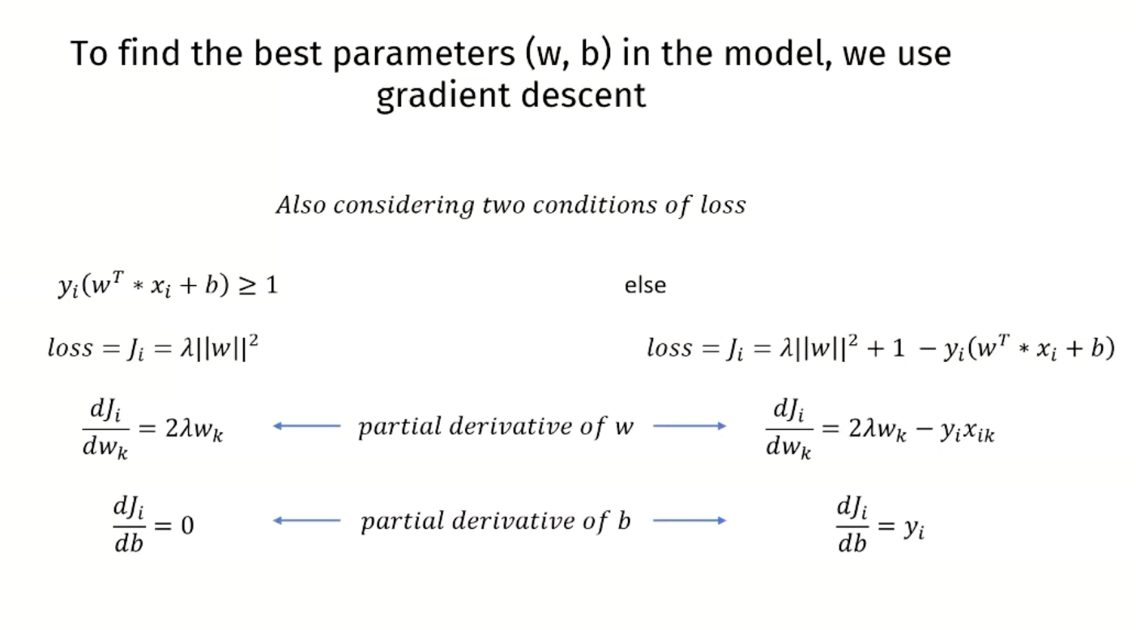

Slide 15
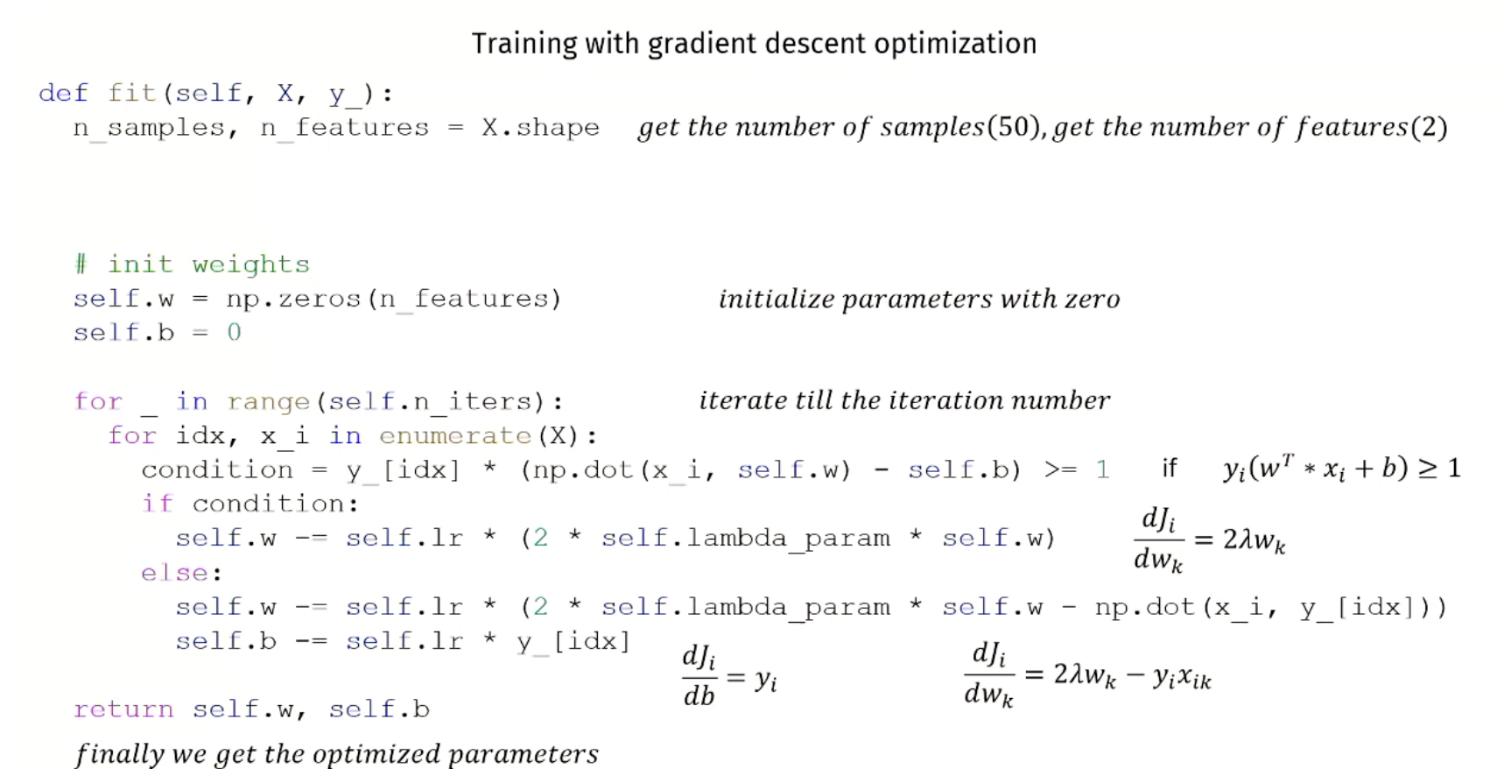

Slide 16
In the context of Support Vector Machines (SVMs), gradient descent algorithms are optimization methods used to find the parameters (weights and biases) that minimize the loss function. The loss function for SVMs is generally the hinge loss, sometimes regularized with an L2 penalty (squared weights) to prevent overfitting. Here's how different gradient descent methods apply to SVM training:
Batch Gradient Descent:
Process: The gradient of the loss function is calculated using the entire training dataset. This is computationally intensive as it requires calculating the loss over all training examples to make a single update to the model parameters.
SVM Context: In SVM, this means that every weight update is performed after evaluating the error over the whole training dataset. This can lead to very stable convergence because it uses the true gradient direction, but it's not suitable for very large datasets due to the high computation cost per iteration.
Stochastic Gradient Descent (SGD):
Process: Unlike batch gradient descent, SGD updates the model parameters for each training example one by one. It can lead to quick convergence because it makes frequent updates, but these updates can be noisy and may cause the loss function to fluctuate rather than decrease monotonically.
SVM Context: For SVMs, SGD updates the weights and biases by considering one example at a time. This is often used in large-scale machine learning problems because it's much more memory-efficient and faster per iteration than batch gradient descent.
Mini-batch Gradient Descent:
Process: This is a middle ground between batch gradient descent and SGD. Here, the model parameters are updated for every mini-batch of training examples. This allows for more stable convergence than SGD while still being more efficient than using the full dataset.
SVM Context: The SVM parameters are updated using a subset of the training data at a time. This is more efficient than batch gradient descent and often achieves similar stability in the convergence pattern with appropriately chosen mini-batch sizes.

Slide 17
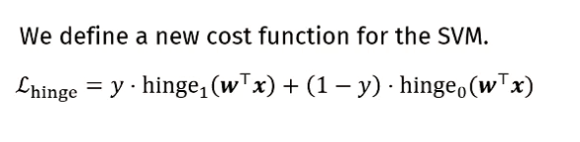
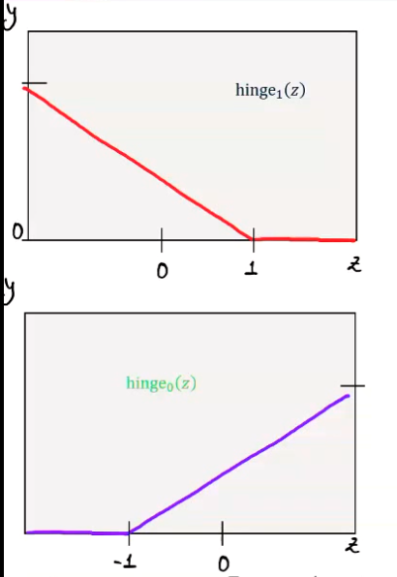
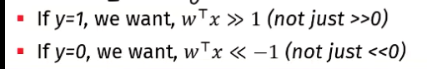
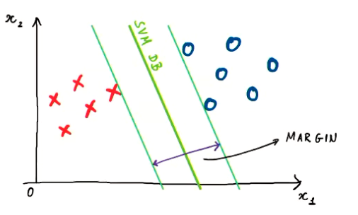
Cost Function of SVM
In SVMs with the RBF kernel:
C: Controls the trade-off between achieving a smooth decision boundary and classifying training points correctly. Lower values lead to a softer margin, allowing more misclassifications but potentially improving generalization. Higher values impose a harder margin, aiming to classify all training points correctly but risking overfitting.
Gamma γ: Determines the influence of a single training example on the decision boundary. Small values result in a smoother boundary, while larger values make it more irregular, potentially leading to overfitting, especially with noisy or non-representative datasets.

Slide 18
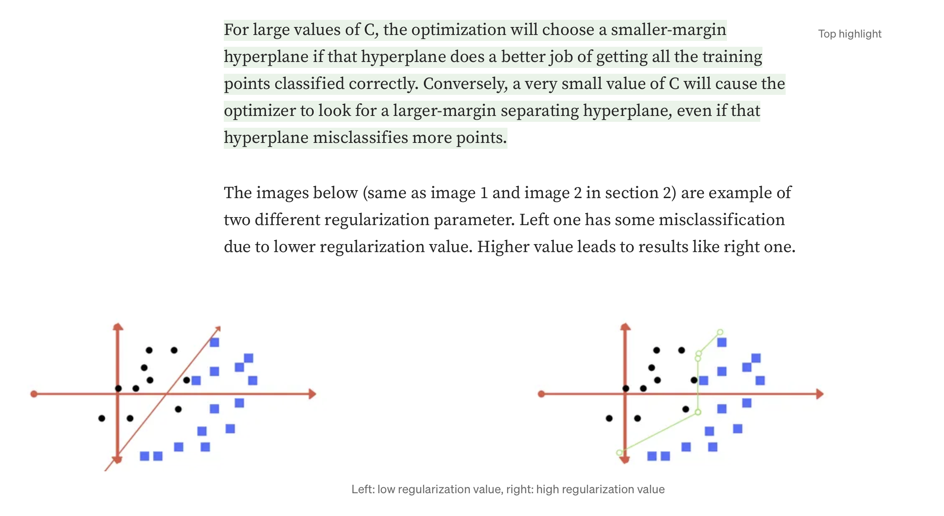
Regularisation Parameter –low lamda – low margin and vice versa

